Slide 1

Bellabeat
Case Study
Bellabeat Product Marketing Enhancement

Slide 2
Bellabeat Case Study
Bellabeat Product Marketing Enhancement
Created and Presented By: Amanda Mann
2024

Slide 3

TABLE OF CONTENTS
Our Big Questions
Our Fact-Finding
Our Deliverables
Our Recommendations
Our Sources

Slide 4
Our Big Questions
Who is in our market?
What do we know about them?
Where can we serve our market?
When do they need our products?
Why do they need our products?
How can we increase our product reach?

Slide 5


Slide 6
Serving Women
Bellabeat is committed to the health and wellness of women.

Slide 7
Our Audience is Mostly Women
They encompass all economic backgrounds
Have varied careers and commitments
Want to feel great about life
Are trying to balance their time
> We Can Serve Them All Through Fair Buy-In
> We Can Identify Further Needs to Support Careers and Commitments of Women
> We Can Encourage Health & Wellness
> We Can Help Them Shine and Have More Quality Time in Their Roles

Slide 8
Bellabeat Products Are Intuitive For Women
Meet & Greet with Bellabeat
A pioneer in the fem-tech realm, Bellabeat is a women’s wellness company that has helped millions of women track their cycle,pregnancies, and live more in sync with their cycles.
Founded in 2014, Bellabeat is the company that developed one of the first wearables specifically designed for women and has since gone on to create a portfolio of digital products for tracking and improving the health of women.

Slide 9
OUR NUMBERS
1 Million+
Devices Synced
10 Million
Users
380 Million
Cycles
Tracked
2 Million
Pregnancies
Tracked

Slide 10
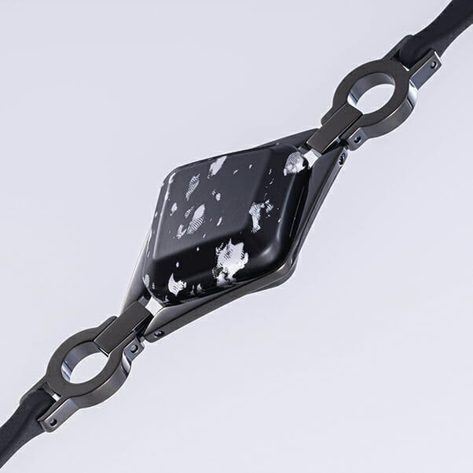
IVY+
Healthtracker

Slide 11
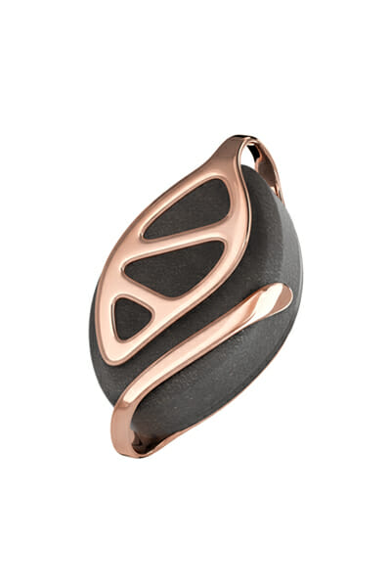
Leaf Urban

Slide 12
Analysis of a 30 day study dataset completed in 2016
from Fitbit Users will be used
for our presentation

Slide 13
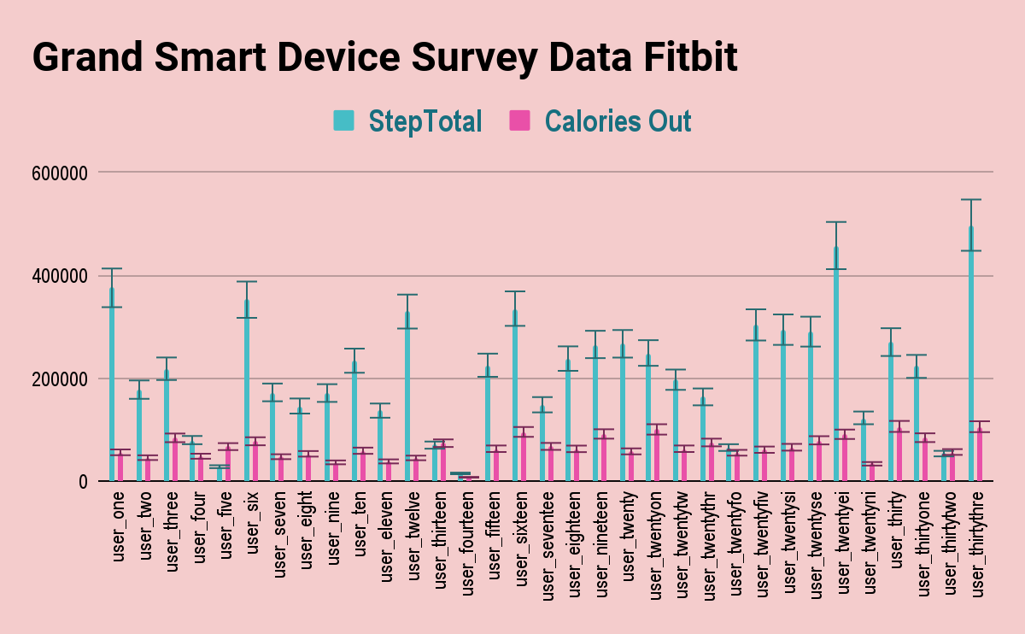

Slide 14
Our Chart Showed Us That…
Steps Tracked Do Not Always Equate To Caloric Burn/Output.

Slide 15
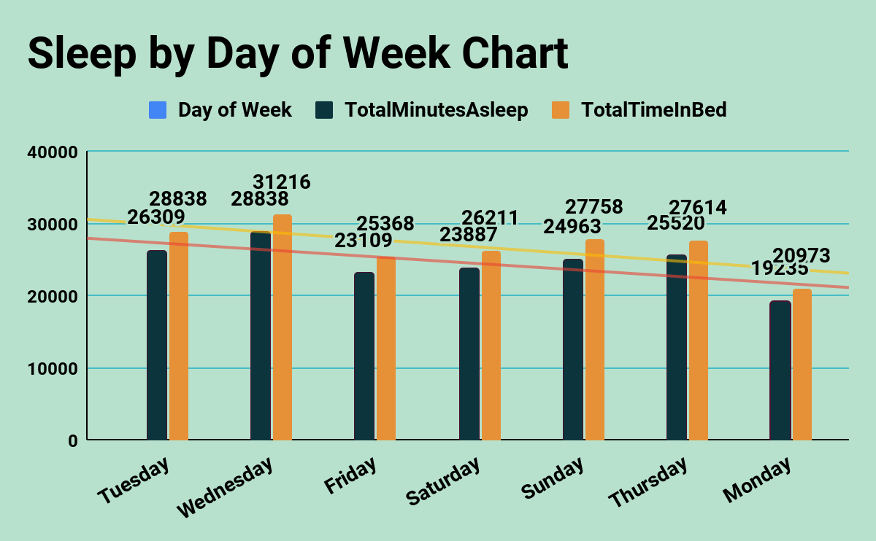

Slide 16
Our Chart Showed Us That…
Wednesdays are for more sleep!
df

Slide 17
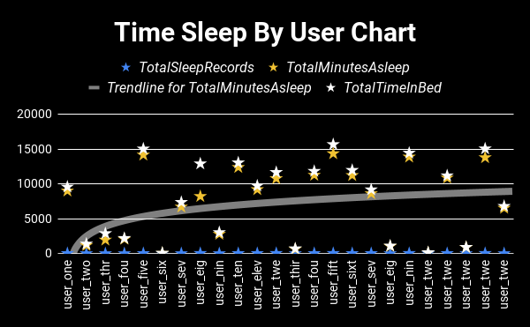

Slide 18
419 Average Minutes of Sleep

Slide 19
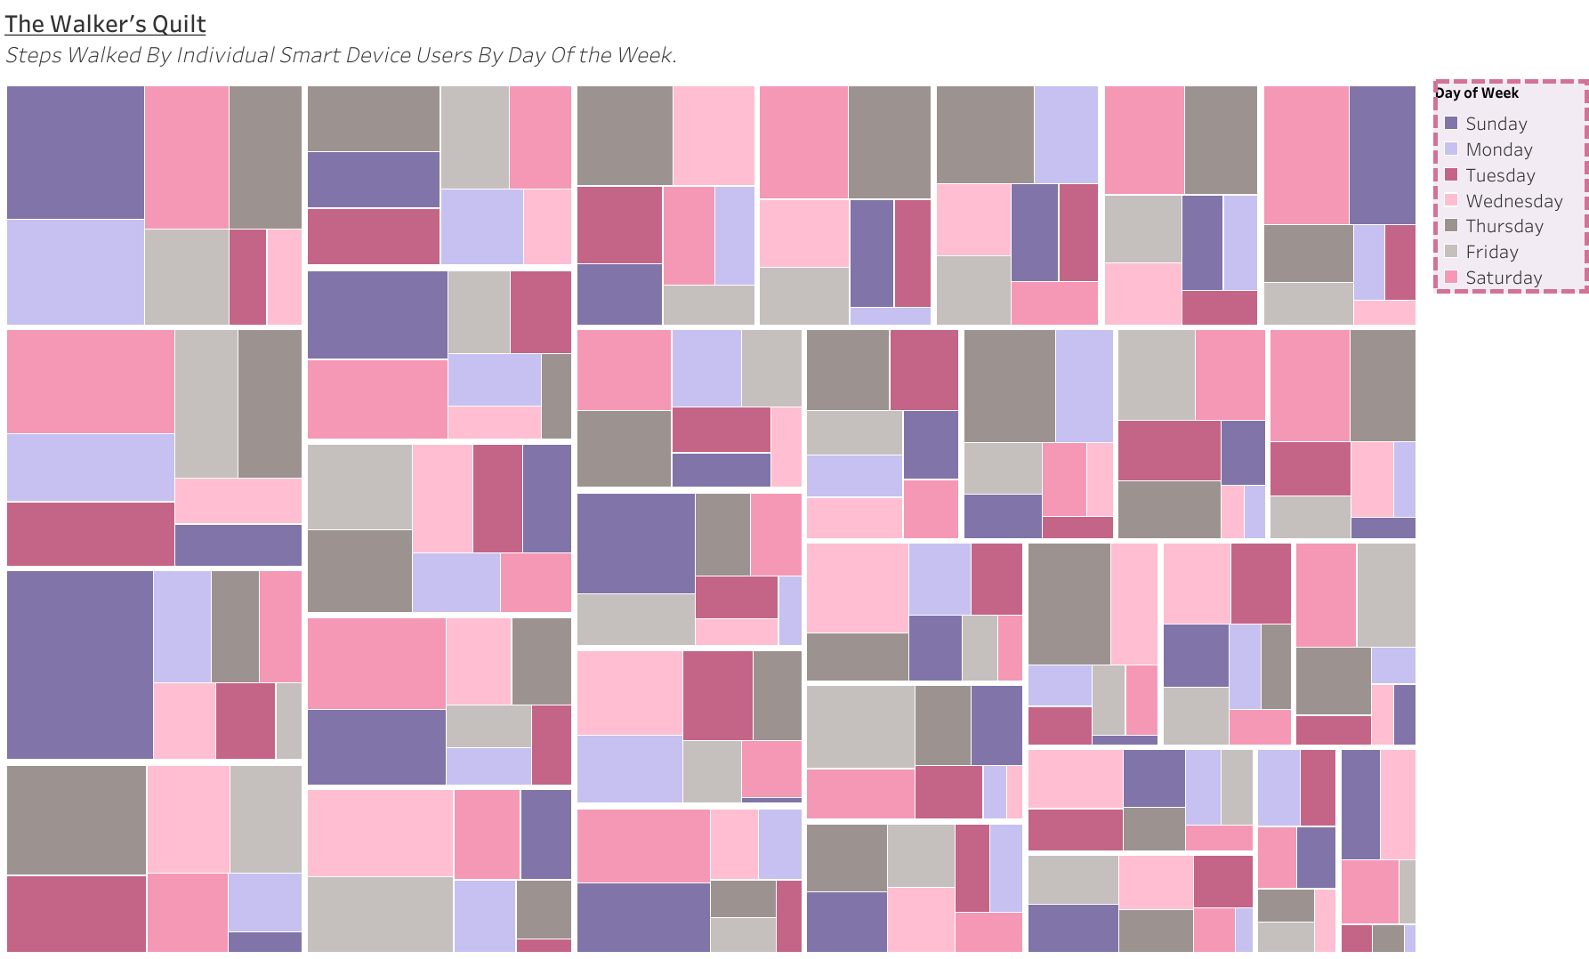

Slide 20
The Chart Showed Us That…
Women’s Lives Can Be Hectic
Inconsistent Activity Levels Exist
Women Adapt To The Day
The Day Doesn’t Adapt To Women

Slide 21
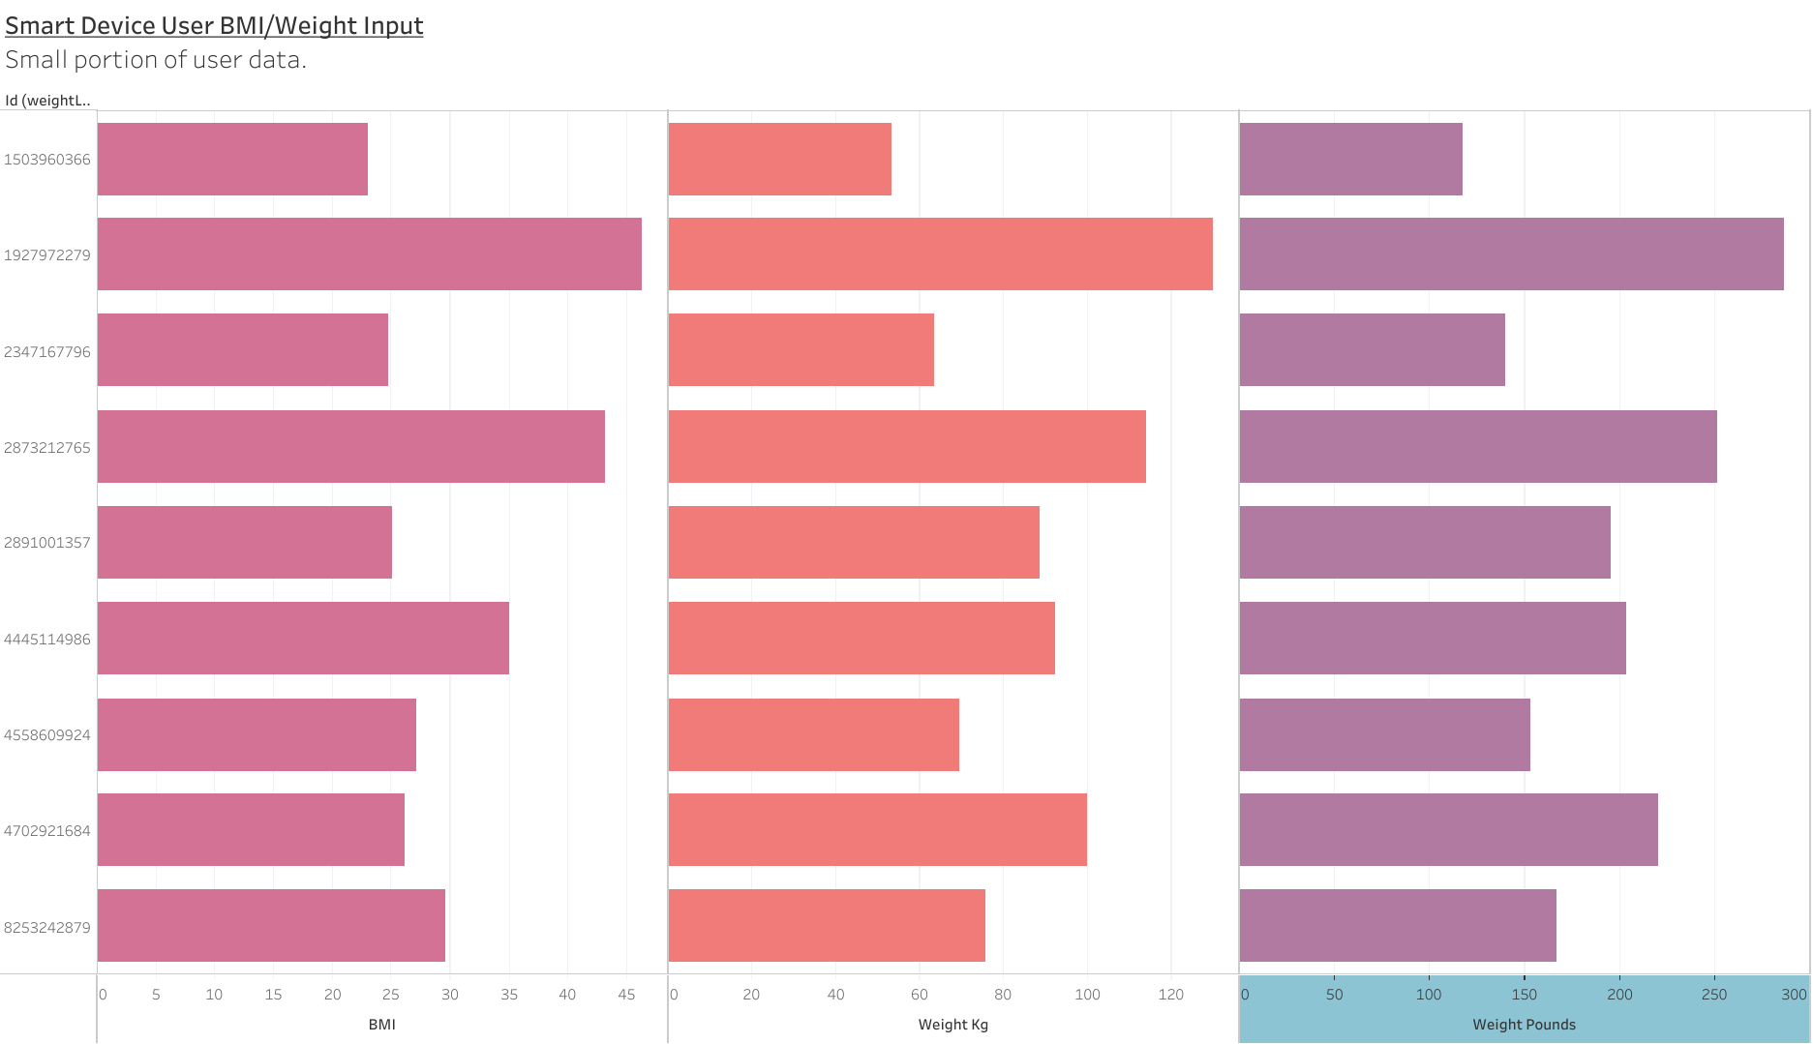

Slide 22
THE AVERAGE BMI OF STUDY PARTICIPANTS WAS 25

Slide 23
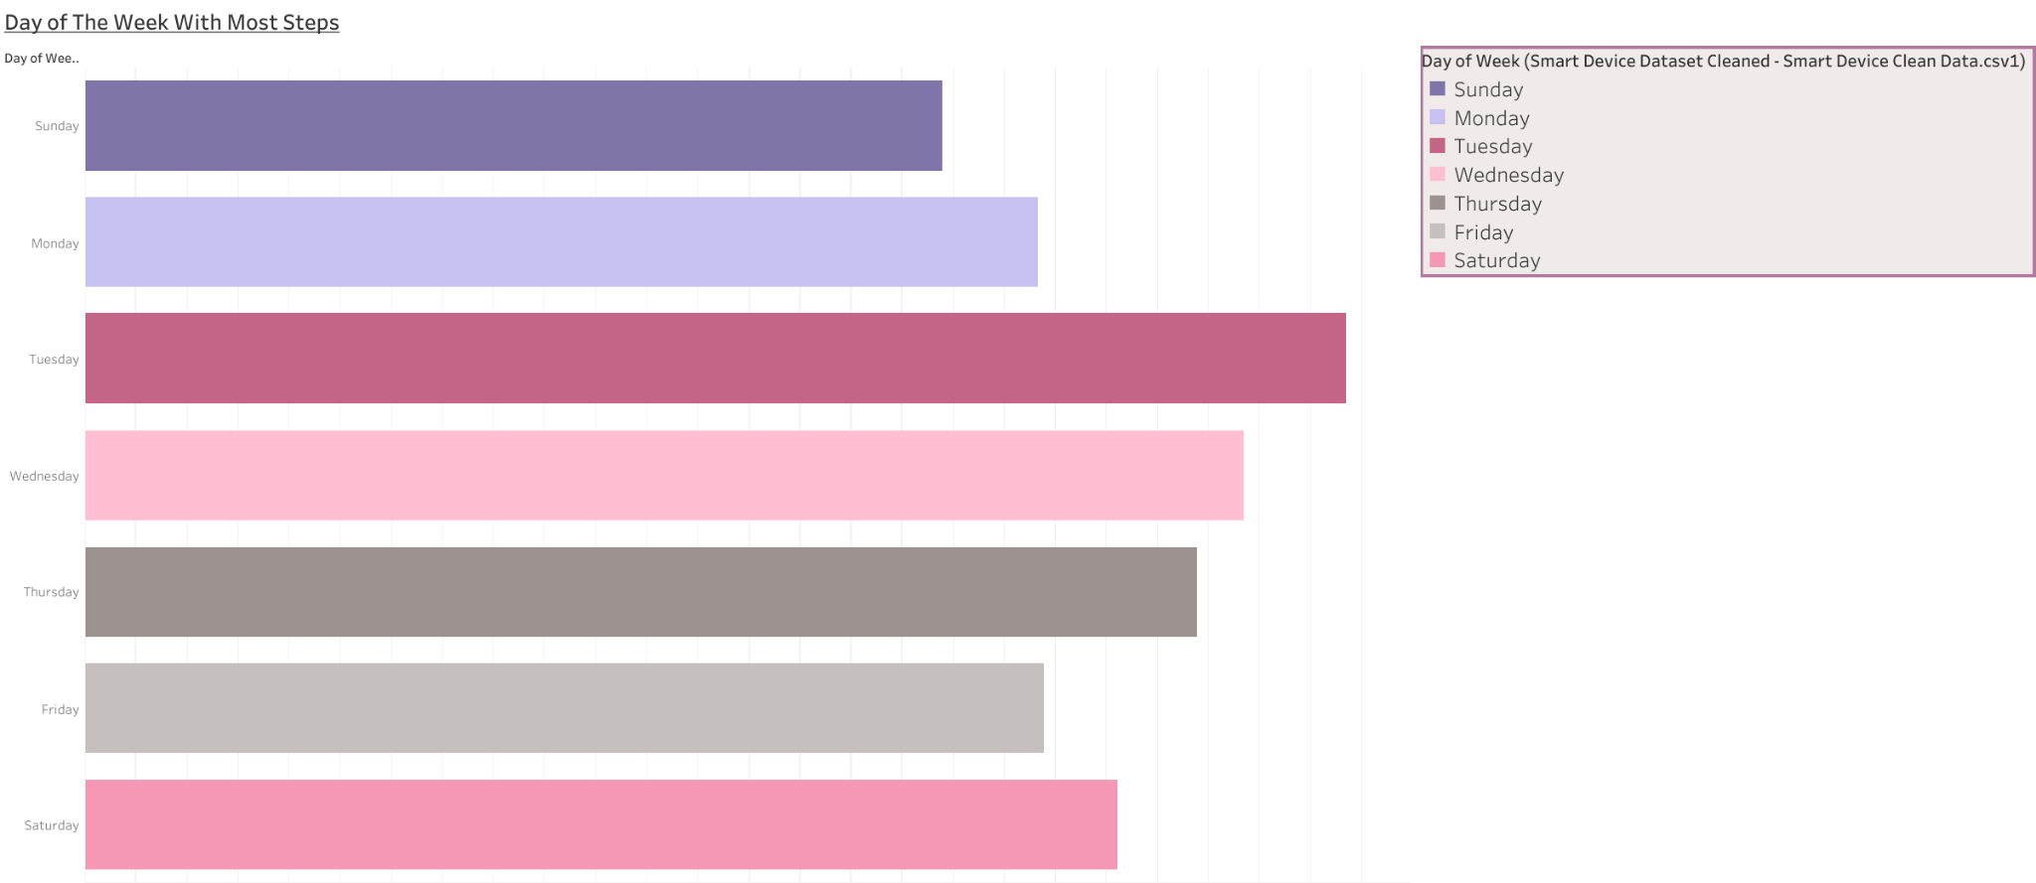

Slide 24
More Steps Tracked On Tuesdays!

Slide 25
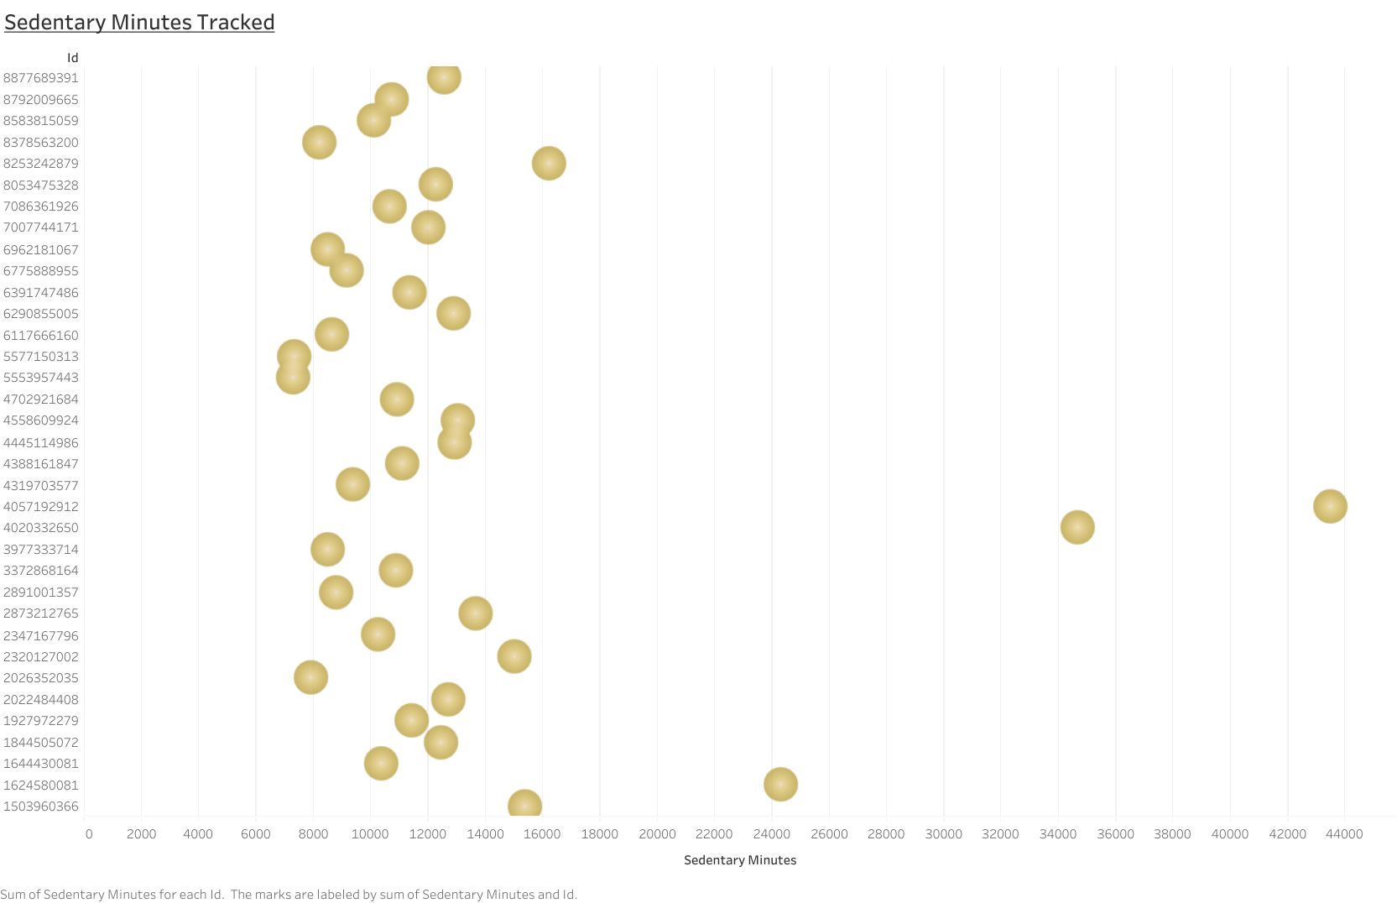

Slide 26
On Average 944 Minutes Are
Tracked as Sedentary Activity
Per Day (Study Analysis)

Slide 27
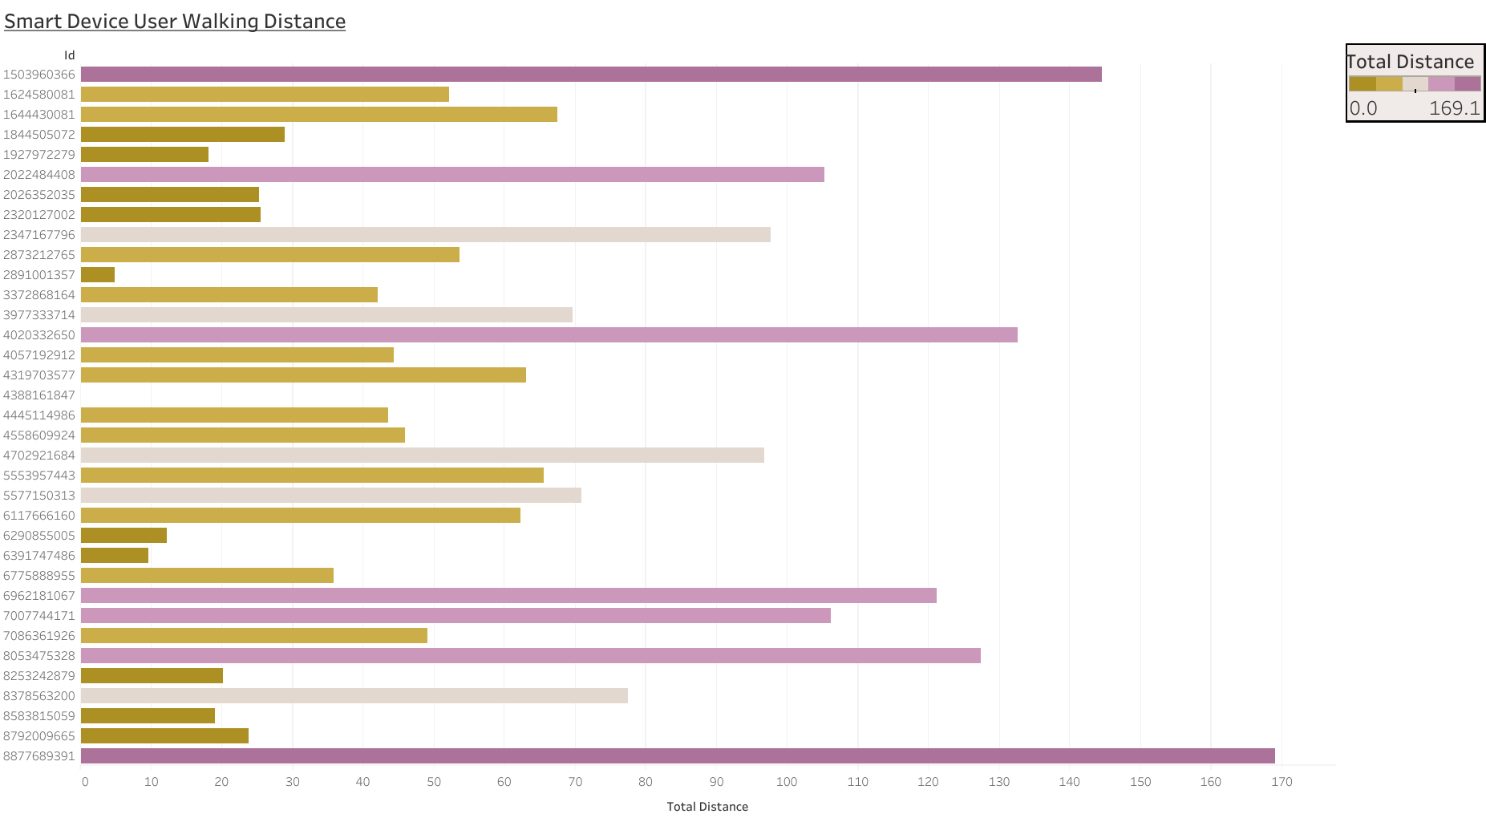

Slide 28
People use less intensity to walk further distances.
4 miles on average is the distance covered walking
at a light and normal pace throughout the day. Most in the study were walking the minimal recommended amount of steps, just slowly.
Less distance in mileage is covered in Moderate Activity tracking; .67 miles on average.
2 miles on average is covered in Very Active Activity tracking. Runners?

Slide 29
I will begin to conclude my presentation with my recommendations and answer questions in a brief Q&A.

Slide 30
RECOMMENDATIONS:
Encourage less sedentary time by 300 minutes less per day
Encourage greater intensity activity levels
Offer Kudos for tracking greater than 5000 steps per day
Incentivize for step increases by blocks (100,500,1000)
Break the walker/jogger by adding unique and fun dynamic challenges
Offer alerts and reminders to move around more once an hour

Slide 31
Questions and Answers
How long was the study duration? 30 Days in 2016
How big was the sample population? 30 Users
Who Conducted the study? Mturk Sample/Public Dataset
Were there Outliers? Yes, there were four outliers.
How was Data analyzed? Sheet-Clean,Sort, and Validate
How was Data visualized? Sheets, Tableau, RStudio
Concerns about Data? Yes. What would you like to know?

Slide 32
Kiitos!
Thank You!

Slide 33
Sources:
Dataset
Analysis of Dataset
Bellabeat Dashboard
Journal Article
CDC
Caloric Myths
Bellabeat

